Slide 1
Graph Data Structure

Slide 2
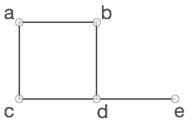
Graph
A graph is a pictorial representation of a set of objects where some pairs of objects are connected by links.
The interconnected objects are represented by points termed as vertices, and the links that connect the vertices are called edges.
Formally, a graph is a pair of sets (V, E), where V is the set of vertices and E is the set of edges, connecting the pairs of vertices.
In the above graph,
V = {a, b, c, d, e} E = {ab, ac, bd, cd, de}

Slide 3
Graph Data Structure
Mathematical graphs can be represented in data-structure. We can represent a graph using an array of vertices and a two dimensional array of edges.
Before we proceed further, let's familiarize with some important terms −
Vertex − Each node of the graph is represented as a vertex.
Edge − Edge represents a path between two vertices or a line between two vertices.
Adjacency − Two node or vertices are adjacent if they are connected to each other through an edge.
Path − Path represents a sequence of edges between two vertices.
Cycle: A path that starts and ends on the same vertex

Slide 4
Directed Graph: A graph that entail edges with ordered pair of vertices and has direction indicated with an arrow.
Undirected Graph: A graph that entail edges with ordered pair of vertices, however it does not have direction define.
Weighted Graph: A graph in which each edge carries a value.
Complete Graph: A graph in which every vertex is directly connected to every other vertex.
In a complete graph every vertex is adjacent to every other vertex.
If there are N vertices then there will be N(N-1) edges in case of complete directed graph and N(N-1)/2 in case of complete undirected graph.

Slide 5
Degree
In an undirected graph degree of a vertex V is number of edges connected to vertex V.
In a directed graph out-degree of a vertex V is number of edges leaving vertex V. It’s in-degree is number of edges ending at vertex V.
Subgraph: If graph G=(V, E) Then Graph G'=(V',E') is a subgraph of G if V' ⊆ V and E' ⊆ E
Tree: undirected, connected graph with no cycles
Spanning tree: A spanning tree of G is a connected subgraph of G that is a tree

Slide 6
Graph Representations
Following two are the most commonly used representations of graph. 1. Adjacency Matrix 2. Adjacency List
There are other representations also like, Incidence Matrix and Incidence List.

Slide 7
Adjacency Matrix
Adjacency Matrix is a 2D array of size V x V where V is the number of vertices in a graph.
Let the 2D array be adj[][],
a slot adj[i][j] = 1 indicates that there is an edge from vertex i to vertex j.
Adjacency matrix for undirected graph is always symmetric.
Adjacency Matrix is also used to represent weighted graphs.
If adj[i][j] = w, then there is an edge from vertex i to vertex j with weight w.

Slide 8
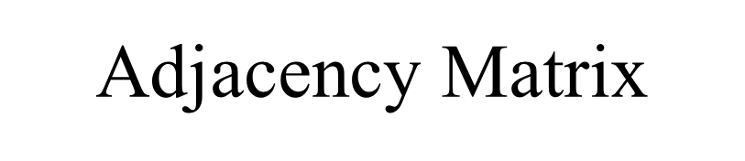
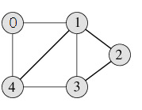
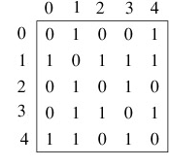
The adjacency matrix for the above example graph is:

Slide 9
Weighted Graph with its adjacency matrix
a
b
3
c
4
 | a | b | c | d | e
a | 0 | 4 | 0 | 5 | 0
b | 4 | 0 | 3 | 1 | 1
c | 0 | 3 | 0 | 0 | 5
d | 5 | 1 | 0 | 0 | 2
e | 0 | 1 | 5 | 2 | 0
1
5
1
5
d
e
2

Slide 10
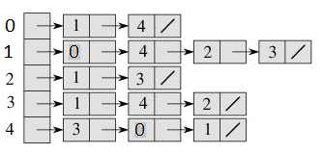
Adjacency List:
An array of linked lists is used.
Size of the array is equal to number of vertices.
Let the array be array[]. An entry array[i] represents the linked list of vertices adjacent to the ith vertex.
This representation can also be used to represent a weighted graph.
The weights of edges can be stored in nodes of linked lists.
Following is adjacency list representation of the above graph.

Slide 11
Transitive Closure of a Graph
Given a directed graph, find out if a vertex j is reachable from another vertex i for all vertex pairs (i, j) in the given graph.
Here reachable mean that there is atleast one path from vertex i to j.
The reach-ability matrix is called the transitive closure of a graph.
Transitive closure can be used to find the reachability analysis of transition networks representing distributed and parallel systems.
It is used in the construction of parsing automata in compiler construction.
Since, almost all recursive queries are transitive in nature, transitive closure computation is being used to evaluate recursive database queries.

Slide 12
Transitive Closure of a Graph
a
b
c
d
e
 | a | b | c | d | e
a | 1 | 1 | 1 | 1 | 1
b | 0 | 1 | 1 | 1 | 1
c | 0 | 1 | 1 | 1 | 1
d | 0 | 1 | 1 | 1 | 1
e | 0 | 1 | 1 | 1 | 1
T =
Reachability/Path Matrix or Transitive closure of graph given

Slide 13
Exercise.....
Represent following graphs in Adjacency Matrix and Adjacency List form. Write Transitive closure too.
a
b
d
c
a
b
d
c

Slide 14
Graph Traversals
There are two possible traversal methods for a graph:
Depth-First Traversal
Breadth-First Traversal

Slide 15
Depth First Search Traversal
Depth First Search algorithm(DFS) traverses a graph in a depthward motion and uses a stack to remember to get the next vertex to start a search when a dead end occurs in any iteration.
Algorithm
Visit adjacent unvisited vertex. Mark it visited. Display it. Push it in a stack.
If no adjacent vertex found, pop up a vertex from stack. (It will pop up all the vertices from the stack which do not have adjacent vertices.)
Repeat step 1 and 2 until stack is empty.

Slide 16
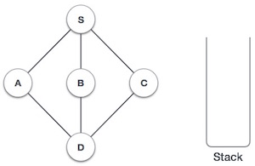
DFS Example
1. Initialize the stack

Slide 17
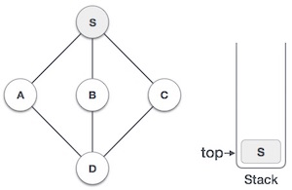
2. Mark S as visited and put it onto the stack.
Explore any unvisited adjacent node from S.
We have three nodes and we can pick any of them.
For this example, we shall take the node in alphabetical order.
Output - S

Slide 18
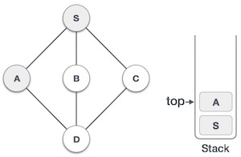
3. Mark A as visited and put it onto the stack.
Explore any unvisited adjacent node from A.
Both S and D are adjacent to A but we are concerned for unvisited nodes only.
Output – S-A

Slide 19
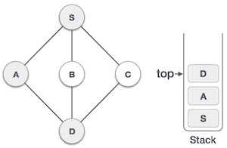
4. Visit D and mark it visited and put onto the stack.
Here we have B and C nodes which are adjacent to D and both are unvisited.
But we shall again choose in alphabetical order.
Output – S-A-D

Slide 20
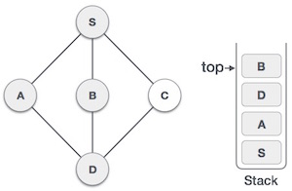
5. We choose B, mark it visited and put onto stack.
Here B does not have any unvisited adjacent node. So we pop B from the stack.
Output – S-A-D-B

Slide 21
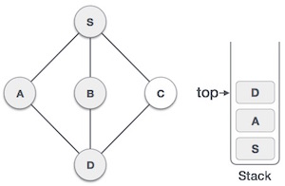
6. We check stack top for return to previous node and check if it has any unvisited nodes.
Here, we find D to be on the top of stack.
Output – S-A-D-B

Slide 22
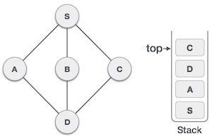
7. Only unvisited adjacent node is from D is C now.
So we visit C, mark it visited and put it onto the stack.
Output – S-A-D-B-C
8. As C does not have any unvisited adjacent node so we keep popping the stack until we find a node which has unvisited adjacent node.
In this case, there's none and we keep popping until stack is empty.

Slide 23
Breadth First Search Traversal
Breadth First Search algorithm(BFS) traverses a graph in a breadthwards motion and uses a queue to remember to get the next vertex to start a search when a dead end occurs in any iteration.
Algorithm
Visit adjacent unvisited vertex. Mark it visited. Display it. Insert it in a queue.
If no adjacent vertex found, remove the first vertex from queue.
Repeat step 1 and 2 until queue is empty.

Slide 24
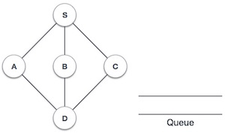
BFS Example
1. Initialize the queue.

Slide 25
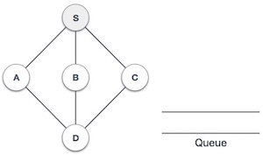
2. We start from visiting S (starting node), and mark it visited.
Output – S

Slide 26
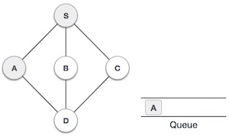
3. We then see unvisited adjacent node from S.
In this example, we have three nodes but alphabetically we choose A mark it visited and enqueue it.
Output – S - A

Slide 27
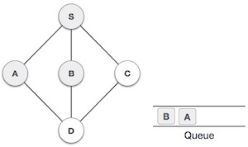
4. Next unvisited adjacent node from S is B.
We mark it visited and enqueue it.
Output – S – A – B

Slide 28
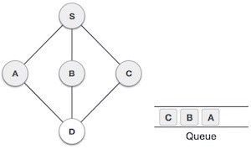
5. Next unvisited adjacent node from S is C.
We mark it visited and enqueue it.
Output – S – A – B – C

Slide 29
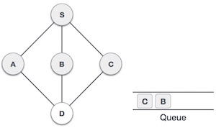
6. Now S is left with no unvisited adjacent nodes. So we dequeue and find A.

Slide 30
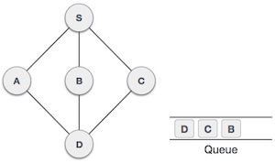
7. From A we have D as unvisited adjacent node. We mark it visited and enqueue it.
Output – S – A – B – C – D
8. At this stage we are left with no unmarked (unvisited) nodes. But as per algorithm we keep on dequeuing in order to get all unvisited nodes.
When the queue gets emptied the program is over.

Slide 31
Exercise.....
Get DFS and BFS for following graph.
a
b
c
g
d
e
f

Slide 32
Exercise.....
Get DFS and BFS for following graph.
a
b
c
g
d
e
f
DFS traversal sequence: a, b, c, e, d, f, g.
The BFS sequence: a, d, e, b, c, f, g.

